Slide 1
CHAPTER 15
Writing Careful Long Reports
Philip C. Kolin
University of Southern Mississippi

Slide 2
Characteristics of a Long Report
(slide 1 of 2)
Long reports are major projects in the workplace. They differ from short reports in how they are written and how they are organized. Note these aspects of long reports as compared to short reports:
  Scope. Long reports provide an in-depth view of a key problem or idea. They examine the problem in detail. Short reports cover just one part of the problem.
  Research. Long reports requires much more extensive research than short reports.
  Format. Long reports are too detailed and complex to be organized in the memo or letter format used for short reports.

Slide 3
Characteristics of a Long Report
(slide 2 of 2)
    Long reports contain more parts, sections, headings, subheadings, documentation, and supplements.
  Timetable. Long reports explore with extensive documentation a subject involving personnel, locations, costs, safety, or equipment. Short reports are often written as a matter of duty and the written may be given very little advance notice.
  Audience. The audience for a long report is generally broader than that for a short report, but long reports are primarily intended for people in the top levels of management.
  Collaborative Effort. Long reports, unlike short reports, are often the product of the work of several individuals.

Slide 4
The Process of Writing a Long Report
The following guidelines will help you plan and write a long report:
  Identify a significant topic.
  Conduct research.
  Expect to confer regularly with your supervisor.
  Revise you work often.
  Keep the order flexible at first.
  Prepare both a day-to-day calendar and a checklist.

Slide 5
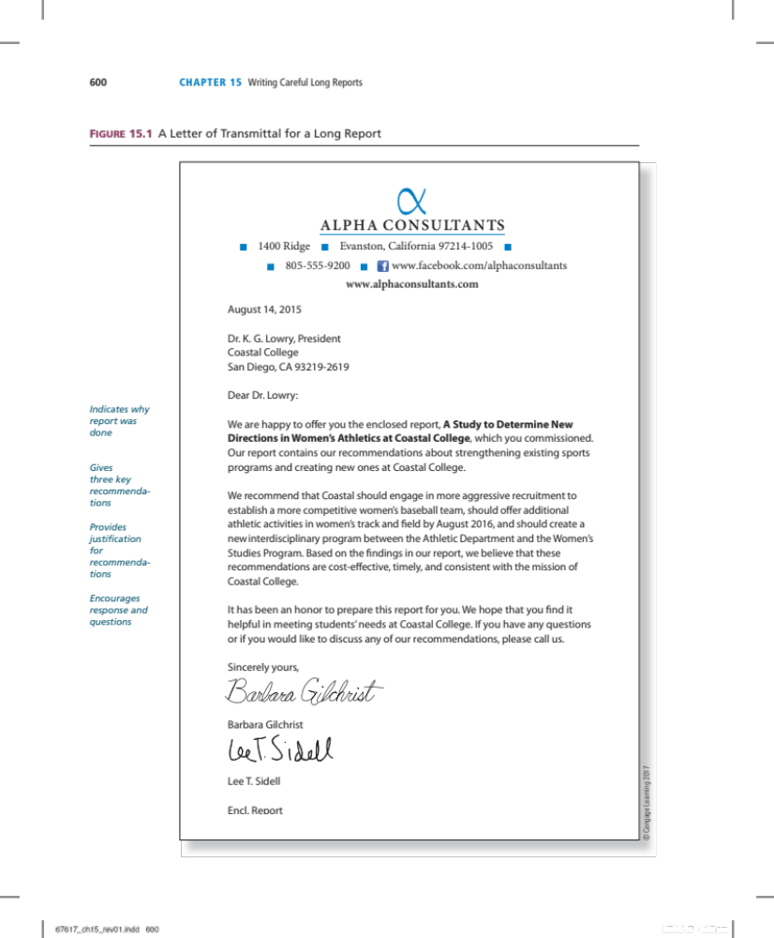
Figure 15.1 A Letter of Transmittal for a Long Report

Slide 6
Parts of a Long Report (slide 1 of 2)
You will use two sets of numbers for the pages of your long report. The front matter uses lowercase Roman numerals (i, ii, iii, etc). The text and back matter use Arabic numerals (1, 2, 3, etc.)
The twelve parts of a long report fall into three broad categories:
  Front matter consists of everything that precedes the actual text of the report: letter of transmittal, title page, table of contents, list of illustrations, and abstract.

Slide 7
Parts of a Long Report (slide 2 of 2)
  Report text encompasses the main section of the report: introduction, body, conclusion, and recommendations.
  Back matter includes all of the supporting data: glossary, references cited, and appendices.

Slide 8
Front Matter (slide 1 of 2)
The front matter includes:
  Letter of transmittal. The letter of transmittal is a one-page letter stating the purpose, scope, and major recommendation of the report.
  Title page. The title page includes the full title of the report, which should be clear and neither too short or nor too long.
  Table of contents. The table of contents should list the major heading and subheadings of the report and provide page numbers.

Slide 9
Front Matter (slide 2 of 2)
  List of illustrations. The list of illustrations contains titles for all of the visuals and indicates where in the report they can be found.
  Abstract. The abstract summarizes the report, including the main problem you have investigated, the conclusions you reached, and any recommendations you may make.

Slide 10
Text of the Report (slide 1 of 2)
The report text includes:
  Introduction. The introduction should make up to 10-15% of your report, but not much more. It should include background information, identification of the problem, a purpose statement, and an indication of the report’s scope.
  Body. Also called the discussion, the body takes up most of the report (around 70%). It contains statistical information, details, physical descriptions, and interpretations by authorities. It should be organized in clearly labelled sections.

Slide 11
Text of the Report (slide 2 of 2)
  Conclusion. The conclusion should tie everything in the report together and present the report’s findings.
  Recommendations. The recommendations section tells readers what should be done about the findings recorded in the conclusion.

Slide 12
Back Matter
The back matter includes:
  Glossary. The glossary is an alphabetical list, with definitions, of the specialized vocabulary used in the report.
  Citations list. The citations list should include all sources cited when researching the report: websites, books, articles, television programs, interviews, reviews, podcasts, and webinars. Use the format your employer prefers.
  Appendix. The appendix contains supportive data too long to include in the body of the report: lengthy tables, sample questionnaires, budgets and cost estimates, correspondence, case histories, and transcripts.

Slide 13
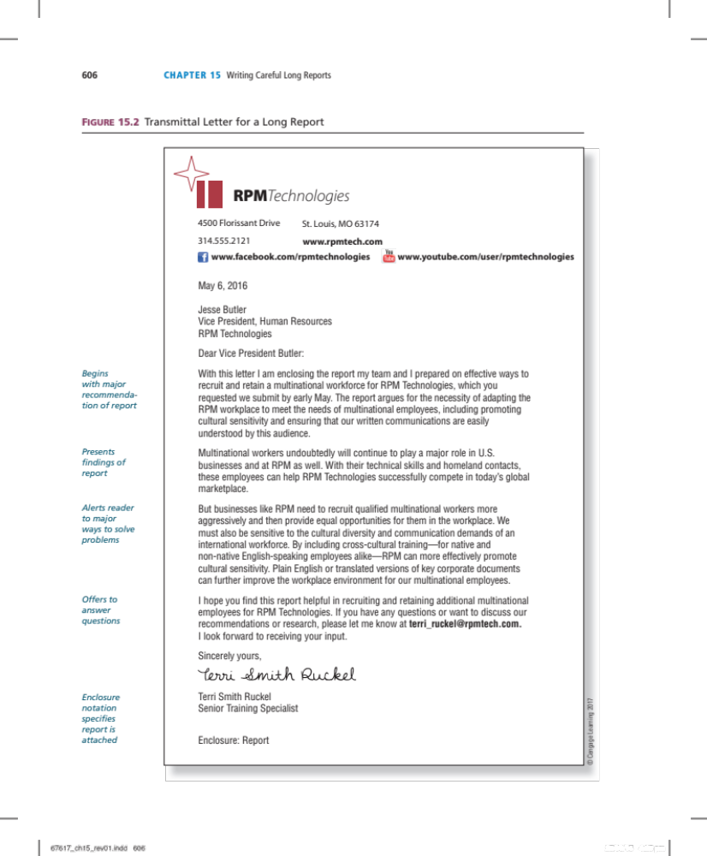
Figure 15.2 Transmittal Letter for a Long Report

Slide 14
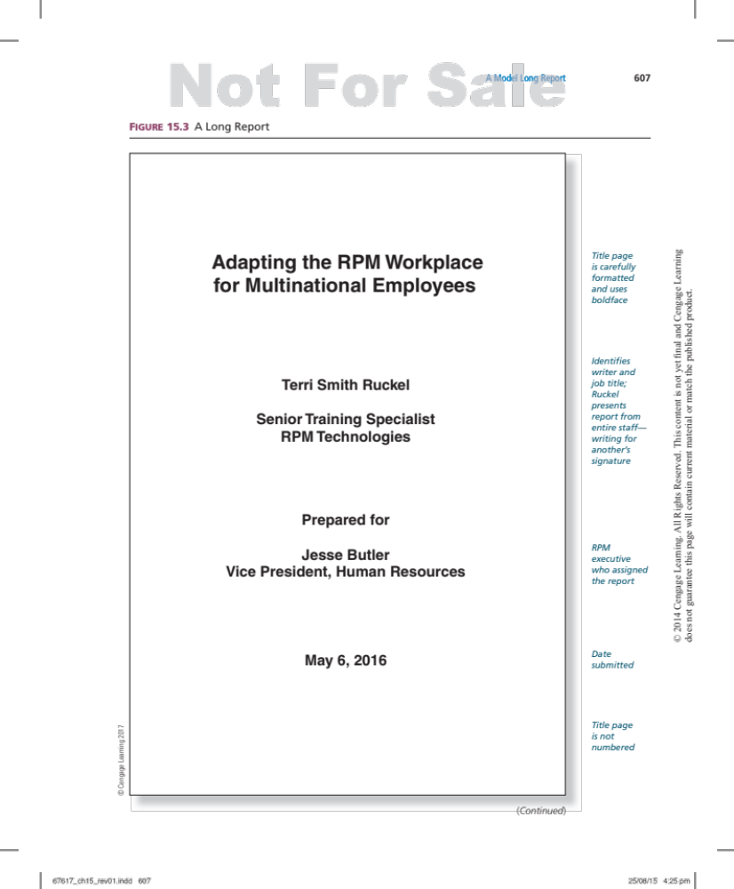
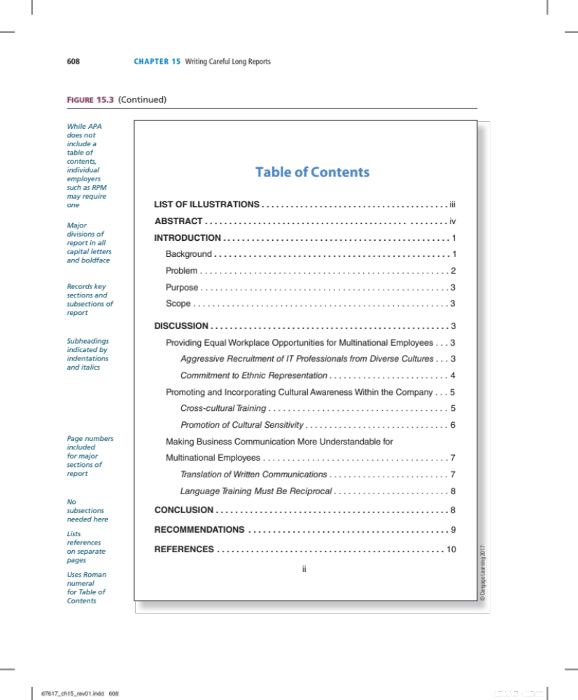
Figure 15.3 A Long Report (slide 1 of 8)

Slide 15
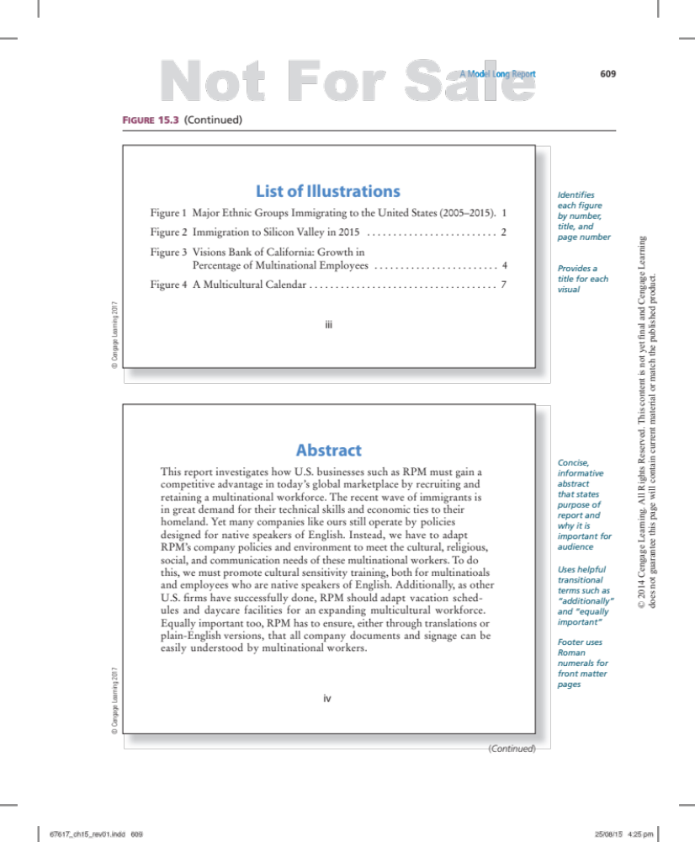
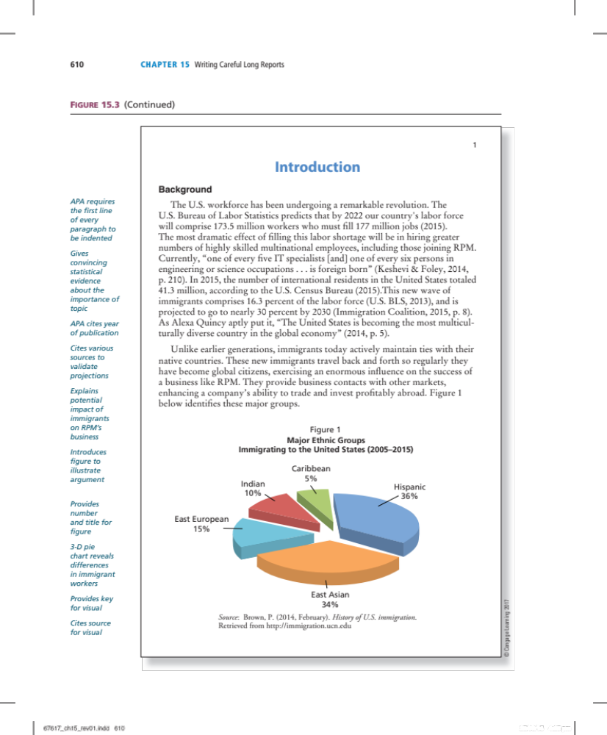
Figure 15.3 A Long Report (slide 2 of 8)

Slide 16
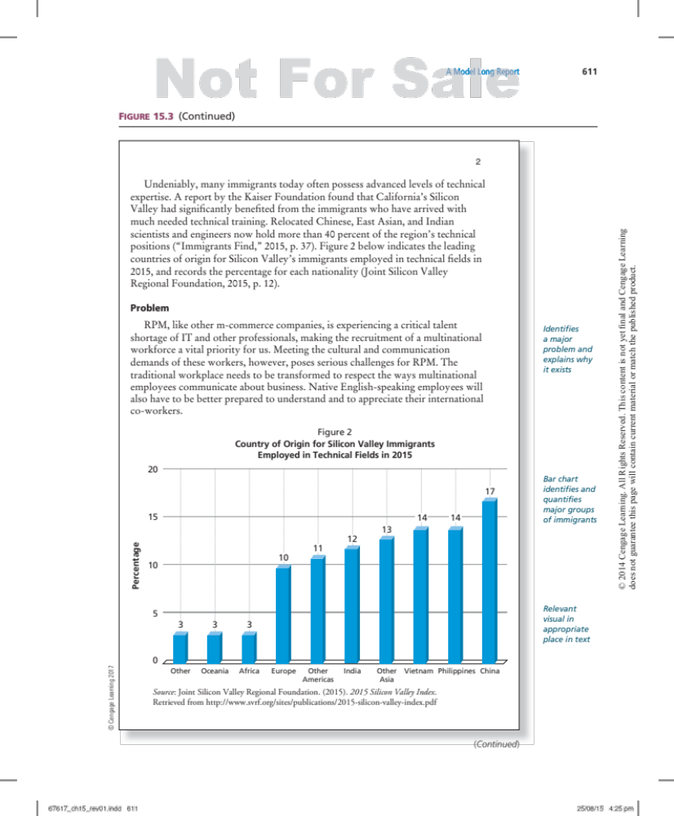
Figure 15.3 A Long Report (slide 3 of 8)

Slide 17
Figure 15.3 A Long Report (slide 4 of 8)

Slide 18
Figure 15.3 A Long Report (slide 5 of 8)

Slide 19
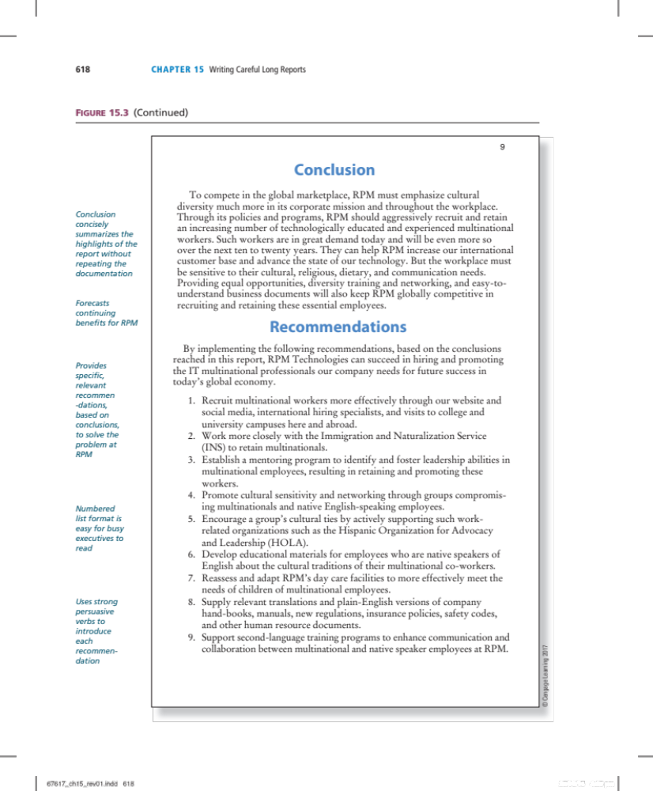
Figure 15.3 A Long Report (slide 6 of 8)

Slide 20
Figure 15.3 A Long Report (slide 7 of 8)

Slide 21
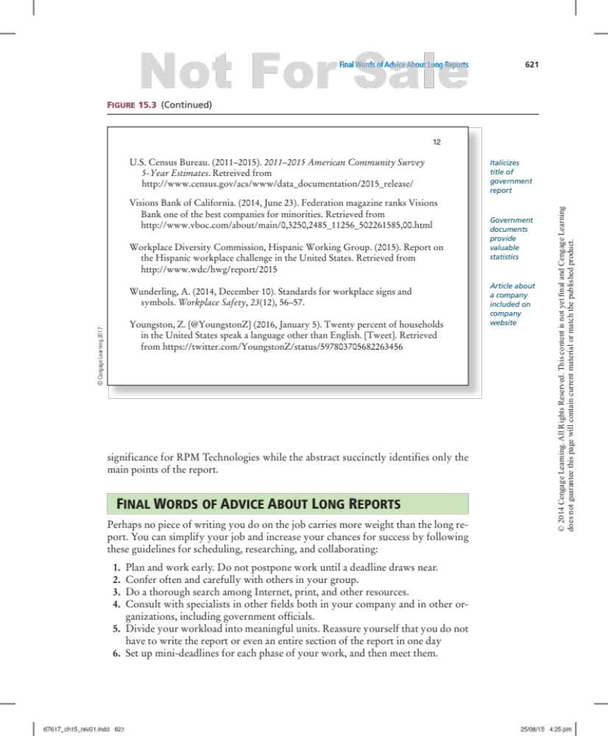
Figure 15.3 A Long Report (slide 8 of 8)

Slide 22
Final Words of Advice About Long Reports
The long report may be the most influential type of writing you do on-the-job.
Remember these guidelines:
  Plan and work early.
  Confer early and often with others in your office.
  Research thoroughly.
  Divide your workload into meaningful units.
  Set up mini-deadlines for each phase of work—and meet them.

